Slide 1
Greedy METHOD

Slide 2

Activity Selection Problem
Suppose you have a series of lectures, all scheduled in one room.
Each Lecture is denoted by a start time and an end time.
You cannot have two lectures in the room at the same time
Two lectures are compatible if their start and finish time do not overlap
What is the maximum number of lectures you can schedule in a day ?

Slide 3
Naïve Solution
Select all the possible subsets of the activities
Find the most non-overlapping ones to fit within the time frame.
Time Complexity O(2^{n})

Slide 4
Recursive Solution
Arrange the events by the finishing time
Not start time, because the maximum time allowed is defined by the latest finishing time
Let i be the activity that can be finished before any other activities in the set;
fi is the minimum among all finishing times
Let j be the activity that will be finished after any other activities in the set;
fj is the maximum among all finishing times
Let the maximum number of events that can be scheduled between start of event i and end of event j be c[i,j]

Slide 5

Recursive Solution
Let ak be an activity between activities i and j
fi <=sk <fk<=fj
Let the maximum number of events that can be scheduled between start of event i and end of event j be c[i,j]
Sij=set of events from which the optimum set is to be selected. All events with finishing time between fi and fj
Acitivity_Selection(Sij, c[i,j])
If Sij is the null set ; c[i,j]=0
Else
T[k]=0;
For every ak 𝞊 Sij
X=Acitvity_Selection (Sik, c[i,k])
Y=Acitvity_Selection (Skj, c[k,j])
T[k]=X+Y+1
C[i,j]=max(T[k]) for all ak 𝞊 Sij
This is also very expensive
Can we do better ?

Slide 6
Reducing Recursion
Activity_Selection(Sij, c[i,j])
If Sij is the null set ; c[i,j]=0
Else
T[k]=0;
For every ak 𝞊 Sij
X=Acitvity_Selection (Sik, c[i,k])
Y=Acitvity_Selection (Skj, c[k,j])
T[k]=X+Y+1
C[i,j]=max(T[k]) for all ak 𝞊 Sij
Activity_SelectionX(Sij, c[i,j])
If Sij is the null set ; c[i,j]=0
Else
T[k]=0;
Select ak with minimum finish time
X=Acitvity_SelectionX(Sik, c[i,k])
C[i,j]=X+1
Take ak as the activity with the earliest finishing time (greedy selection)
Then recursion reduces to a linear problem
Does this guarantee optimum set, i.e. most number of activities ?

Slide 7
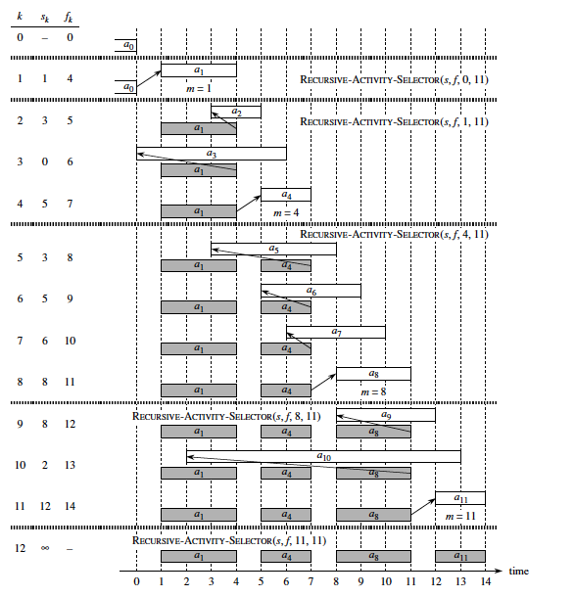

Slide 8
Elements of Greedy Method
Determine optimal substructure of the problem
Develop a recursive solution
Show that at stage of the recursion, only one of the choices (the greedy choice) is best.
Show that if this greedy choice is made, the correct answer is obtained

Slide 9
Proof of Correctness of Greedy Selection:I
S1:If am is the activity with the earliest finishing time finishing time, then Sim will be empty
Recall recusive formula
C[i,j]=c[i,m] +c[m,j]+1 (when am is selected)
If am is the activity with earliest finishing time, then there can be no activity scheduled before it.

Slide 10
Proof of Correctness of Greedy Selection:II
S2: There is an optimum set of activities that start with am (the activity with earliest finishing time)
Suppose Pij is an optimum set of activities that does not include am
Let the first activity in Pij be ap
We can exchange ap with am
Because fp > fm, exchanging am will not conflict with other choices
Thus we have an optimal set that begins with am

Slide 11
Proof of Correctness of Greedy Selection:III
Assume that the set of activities given by the greedy algorithms is Y={y1, y2,….,yn}
Assume that the set of activities given by an optimal algorithm is O={o1, o2,…ok}
We will show |O| (size of set O)=|Y|(size of set Y)
We will do this by showing that all events in O can be replaced with the events in Y

Slide 12
Proof of Correctness of Greedy Selection:IV
In both the sets, the events are arranged in increasing order of their finishing time
Let for events 1 to I oi=yi, so we do not have to replace
So we can consider the set from {yi+1,…yn} and {oi+1,…,ok} (as per S1)

Slide 13
Proof of Correctness of Greedy Selection:V
Let the jth event be the first where oi ≠ yi
As per S2 we can replace yi with oi
This is because finishing time of yi has the earliest finishing time among the remaining events
Thus the finishing time is less than equal to oi and will not conflict with the remaining events in O
…Thus we have reduced the sets to be compared to {y(j+1)…yn} and {o(j+1)…ok}
If we continue we will eventually replace on with yn

Slide 14
Proof of Correctness of Greedy Selection:VI
If there are any events left in O={o(n+1),…ok}, they should have been picked up by the greedy algorithm
This is because they do not conflict with yn, and are part of the set of activities
Since yn is the last event in Y, thus no other activities were selected
Thus on is the last element in O
Hence all events of O can be replaced in all events in Y
|O|=|Y|

Slide 15
Example
Y={1,4,8,11}
O={2,4,9,11}
Step 1; replace 2 with 1
{1,4,8,11}; {1,4,9,11}
Step 2 ; to compare {8,11} and{9,11}; replace 9 with 8

Slide 16
Recap
Can be expressed as a recursive problem similar to divide and conquer and dynamic programming
However, only one subproblem need to be solved
The subproblem selected is the one that gives the optimal value in the current situation
Algorithms must be accompanied with proofs to show why greedy selection works

Slide 17
Fractional Knapsack Problem
You have a bag that can hold upto W pounds. You have n items , where the value of the ith item is v_{i} and the weight is w_{i}. How will you fill your bag such that you maximize your value
In this case the items can be divided divided---rice, coffee beans, gold dust, etc.

Slide 18
Fractional Knapsack Problem
We can try the dynamic programming route and recursively select an item or not per subset
However, since the items can be subdivided we have to consider all possible fractions
That will be enormously expensive
Algorithm
Find the cost per weight of each item v_{i}/w_{i}
Sort them in decreasing order—highest first (Onlogn)
Pick the most valuable item. If all of it is taken and there is space left, pick the next valuable item and so on….

Slide 19
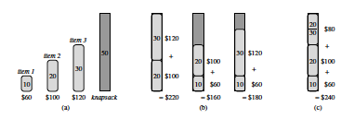
Fractional Knapsack Problem

Slide 20
Proof of Correctness-I
Assume the items are numbered 1 to n in decreasing order of their value by weight
(x1,x2,x3,….,xn)
Let Y be the solution obtained by the greedy algorithm
(y1,y2,y3,…yk,...,yn)
Weight yi of item xi is selected
Considering weight as a percentage, the value of yi would be
1,1,1,…,f,(0,0,..0); where f=yk
Everything before yk is taken completely, then f percentage of yk is taken which fills up the weight.
Let O be the solution obtained by an algorithm that gives the most value
(o1,o2,o3,…..ok,..,on)
Weight oi of item xi is selected

Slide 21
Proof of Correctness-II
If for all items i oi=yi then we are done
Otherwise let us assume that the first item where the values do not match is the jth item
Case I: this is not the kth item then, yj>oj
Let oj+dj=yj
So we add dj to oj to make the weight come up to yj
We delete weight d from the remaining items of oj+1…oj to make up the extra weight
Since we are deecreasing weights of more expensive items and increasing weights of less expensive items, the value is decreased or stays the same.
It should stay the same since we already had optimal value for the max weight
Now weight of items 1 to j, and we can continue the same way.

Slide 22
Proof of Correctness-III
The first mismatch is when the item is the kth item
If yk > ok, it is case 1
Case 2: If yk<ok
Since from 1 to k-1 the weights are equal, therefore the amount of weight left is yk. Thus ok has to be equal to yk

Slide 23
Example
Maximum Weight
6 pounds
Items :
1: 1 pounds=>$6 ; v/w=6
2: 2 pounds=>$10; v/w=5
3: 5 pounds =>$25; v/w=5
Solution 1 (Greedy)
Item 1(1), 2(2), 3(3) =$6+$10+$3*5=$31
Optimal Solution
Item 1 (1),2(1), 3(4)=$6+$5+$20=$31

Slide 24
Example
List of items in decreasing order of v/w {1,2,3}
Y={1,2,3}
O={1,1,4}
Step 1; add 1 to item 2 in O and remove 1 from item 3
O={1,2,3}=$31

Slide 25
Huffman Coding
Consider a string that has only six letters, with varying frequencies
A(45%); B(13%); C(12%); D(16%); E(9%); F(5%)
How would you encode the letters using binary digits?

Slide 26
Encoding the Letters
A=000; b=001, C=010, D=011, E=100, F=101
If there are 100,000 characters in the string then space taken= 3*100,000=300,000 bits
A more efficient coding
A=0, B=101, C=100, D=111, E=1101, F=1100
Going by the frequencies space taken
(45*1+13*3+12*3+16*3+9*4+5*4)*1000=224,000
Would this coding be easy to decode ? How would you do it ?

Slide 27
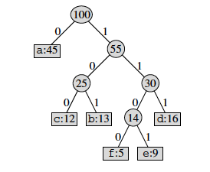
Prefix Codes
Prefix codes are codes in which no code word is also a prefix of some other code word.
If the letters are code using prefix code, we can use a binary tree to decode

Slide 28
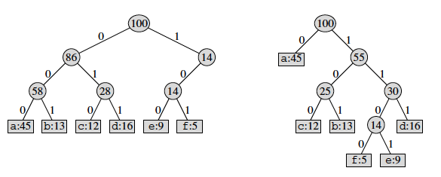
Prefix Codes
Binary Trees corresponding to prefix codes are always full binary trees. Every non-leaf node has two children. Not so for fixed length code

Slide 29
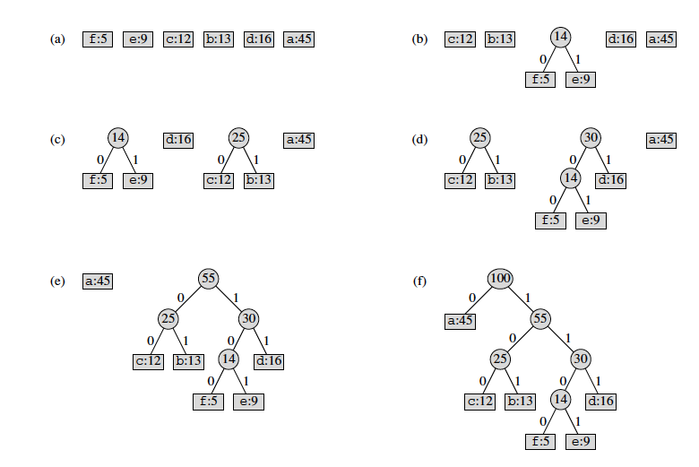
Huffman Coding

Slide 30
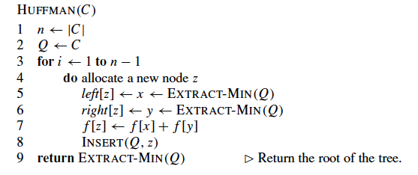
Huffman Coding
Complexity O(nlogn)

Slide 31

Prefix Code
If the string has C different characters then the tree will have C leaves
Since it is a full binary tree, therefore it will have C-1 leaves
The length of the code representing a character is equal to the depth of the tree d(T)
Let the frequency of the character be f(C)
Number of bits to store the string (cost of the tree)
Goal: to minimize this cost

Slide 32
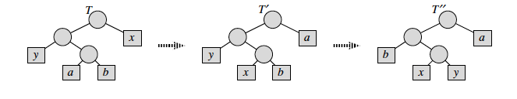
Proof of Correctness-I
Let x and y be two characters of the lowest frequencies.
Then there exists an optimal prefix code for C in which the code for x and y have the same length and differ only in the last bit
Thus x and y will be leaves with same parent in tree (T’’)
Let there be an optimal Huffman code where x and y are not siblings and not on the lowest branch.
Instead a and b are siblings in the lowest branch(T)
We will transform from T to T’’
We can then remove the parent node of x and y, and recursively transform the rest of the trees

Slide 33
Proof of Correctness-II
In the String
Frequency of a=fa
Frequency of b=fb
Frequency of x=fx
Frequency of y=fy
In T
Depth of a=da
Depth of b=db
Depth of x=dx
Depth of y=dy
In T” (exchange position of a and x ; y and b
Depth of a =Depth of x in T=dx
Depth of b =Depth of y in T=dy
Depth of x =Depth of a in T=da
Depth of y =Depth of b in T=db

Slide 34
Proof of Correctness-III
Difference in Storage in T and T’’, assuming all other letters are not moved
In T
fa*da+fb*db+fx*dx+fy*dy
In T”
fa*dx+fb*dy+fx*da+fy*fb
Difference T-T’’
(fa-fx)(da-dx)+(fb-fy)(db-dy)
Since da>=dx; db>=dy; fa>=fx; fb>=fy ; difference is >=0
Which means T>=T’’
But T has the minimum storage according to assumption
Thus T=T’’ and Huffman coding also produces minimum storage.

Slide 35
Spanning Tree
A spanning tree of a graph G is a tree that contains every vertex of G.
The weight of a tree is the sum of its edges’ weights.
A minimal spanning tree is a spanning tree with lowest weight.
6
5
6
5
1
1
5
5
5
5
3
2
3
2
6
4
6
4
6
6
weight = 21
weight = 15

Slide 36
Minimum Weighted Spanning Tree (MST)
A
A
A
1
3
1
1
B
2
2
2
C
2
B
C
B
C
2
2
3
F
2
F
2
F
1
2
1
2
1
D
E
D
E
D
E
Prim’s Method (1957):
Start with a vertex
Pick the smallest weighted edge
Keep picking smallest edge going out of
the current tree
Do not form cycles
Done when all vertex are connected
Kruskal’s Method (1956):
Start with set of disconnected nodes
Pick the smallest weighted edge
Keep picking smallest edge from the set of all edges
Do not form cycles
Done when all vertex are connected

Slide 37
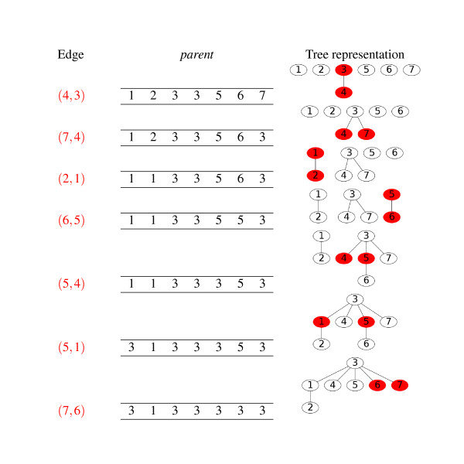
Disjoint Set Union FIND
Image from Ultra-fast sequence clustering from similarity networks with SiLiX

Slide 38
Complexity
Prim’s Algorithm
Time to sort edges by weight in heap = O(ElogE)
Find smallest edge =O(1)
Check if new vertex added =O(V)
Together it comes to O(ElogE)=O(ElogV), since E<=V*V
Can go down to O(VlogV) when sorted using vertices and using Fibonacci heap.
Kruskals’s Algorithm
Initialization of vertices for Union Join =O(V)
Time to sort edges by weight in heap = O(ElogE)
Time to extract minimum weighted edge =O(1)
Time to check for cycle using union find=O(VlogV)
Together it comes to O(ElogE)=O(ElogV), since E<=V*V

Slide 39
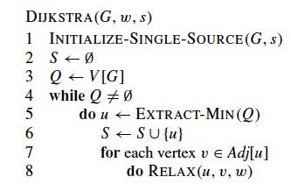
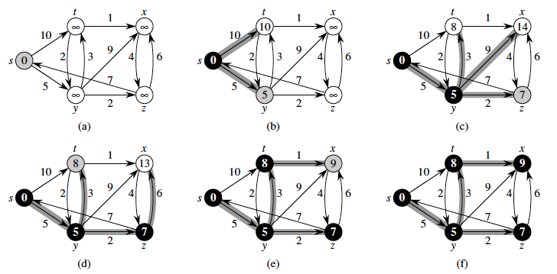
Dijkstra’s ALgorithm
Start at a vertex
Add vertex to priority queue;
priority is lowest weight first
While priority queue not empty
Extract first element in queue; element with lowest distance
If not visited
Mark as visited
Relax distance to neighbors
Add all unvisited neighbors to queue
End if
End while

Slide 40
Examples
For each problem, give the algorithm and the proof
Cost of merging two sorted arrays is equal to the sum of their length. If you have more than two sorted arrays in which order would you merge them to minimize the cost
Example arrays of length 4,2,3,6,5
We want to obtain a given amount V, using the fewest number of dollar bills. We have dollar bills of the following denominations ={1,2,5,10,20,50,100}. We can use as many bills as necessary
Example what is the fewest number of bills to make up $70

